Slide 1
Installing the LEGO® MINDSTORMS® ProgrammER ApP on the Amazon Kindle Fire Tablet
By Sanjay and Arvind Seshan

Slide 2
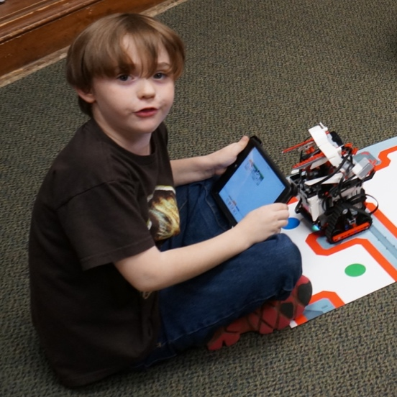
Why the Programmer App and Why Kindle?
Learning to program using the new LEGO MINDSTORMS Programmer App is fun and easy for beginners
It allows you get close to your robot and test your code quickly
Devices such as iPads and many Android Tablets can be expensive
Kindles offer an inexpensive Android-based alternative

Slide 3
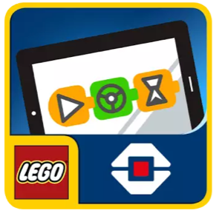
Getting the Programmer Application
Two ways to install this:
If your Kindle supports this app you can download it from the Amazon App Store
Currently the EV3 Programmer app is not supported on common Kindle devices such as Kindle Fire, Fire HD 7 and Fire HD 10
The ev3 programmer app on the Google Play Store is compatible with most/all kindles
Unfortunately, the Play Store currently does not come installed on the Kindle Fire
We explain the steps to install the Google Play Store manually using .apk files (equivalent of .exe, .pkg, .app, .deb, .rpm for Android/Fire OS) in the following slides

Slide 4
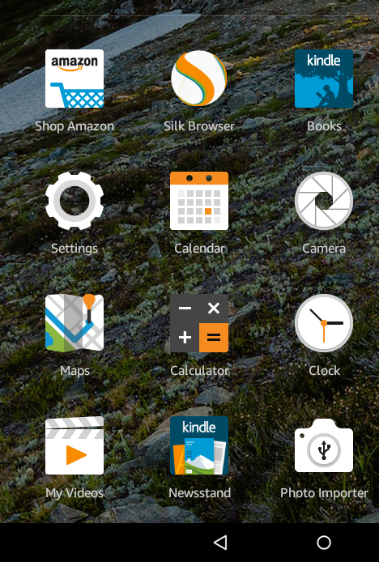
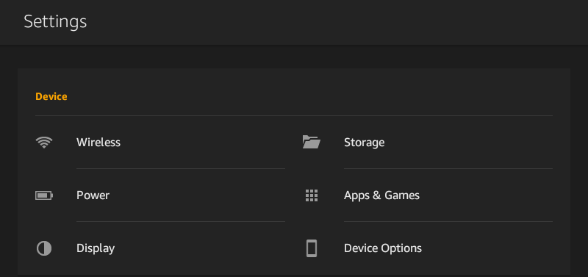
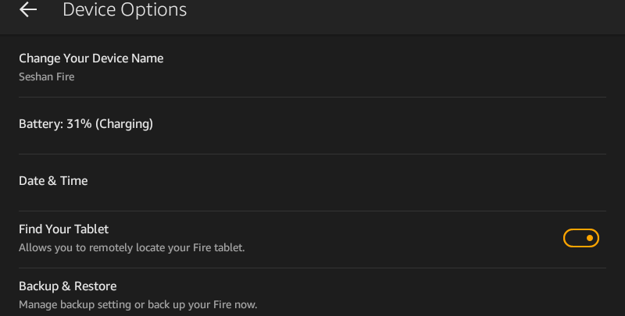
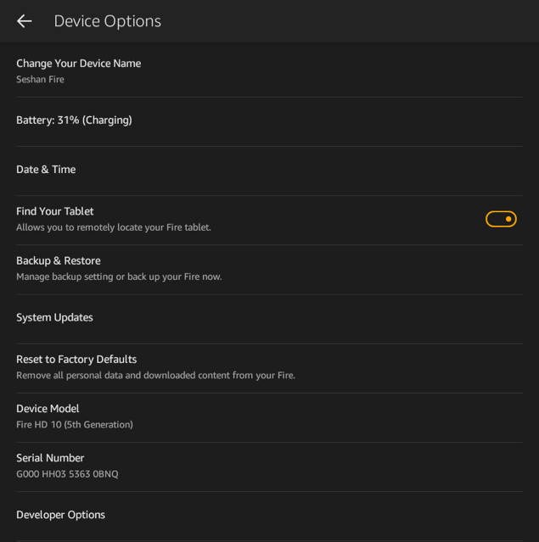
Step 1: Enable Developer Mode
Launch Device Options
Launch Settings
Tap Serial Number until Developer Options appears (about 7 times)

Slide 5
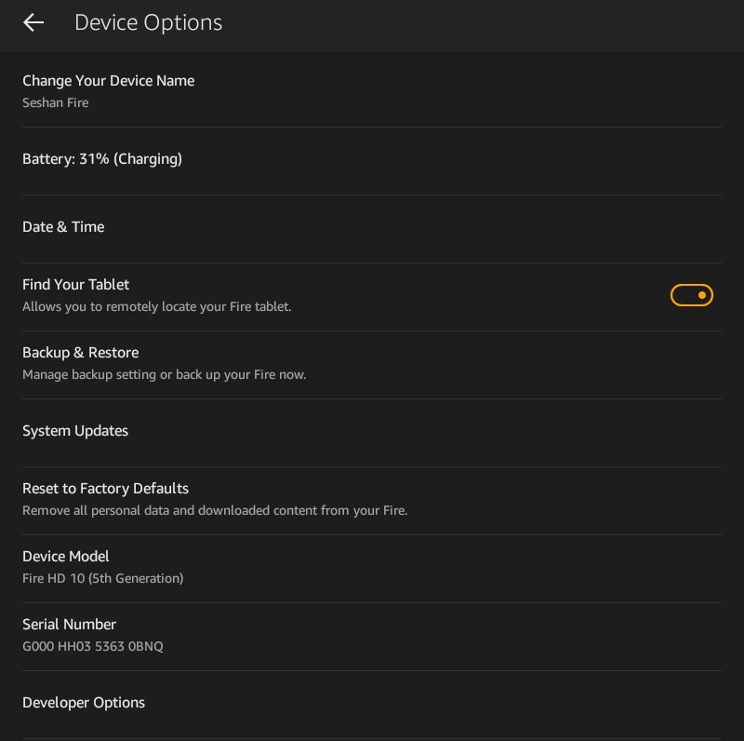
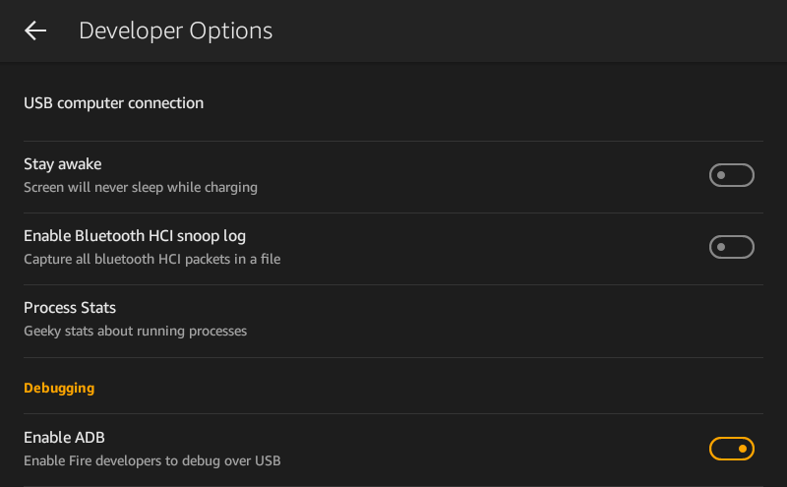
Step 2: Enable ADB
Check Enable ADB and choose enable on the pop-up
Open Developer Options

Slide 6
Step 3: Install APKs (Windows 10+)
Download Amazon-Fire-5th-Gen-Install-Play-Store.zip from http://goo.gl/QtQMrV
Unzip the files
For older versions of Windows (eg. Vista) follow these instructions for the adb driver section: http://www.howtogeek.com/232726/how-to-install-the-google-play-store-on-your-amazon-fire-tablet/

Slide 7
Step 4:
Run the .bat file
A USB Debugging verification may show up on the Kindle, choose OK
Type number 2, and press enter and then any key at the next menu
Reboot your Kindle Fire after you are done

Slide 8
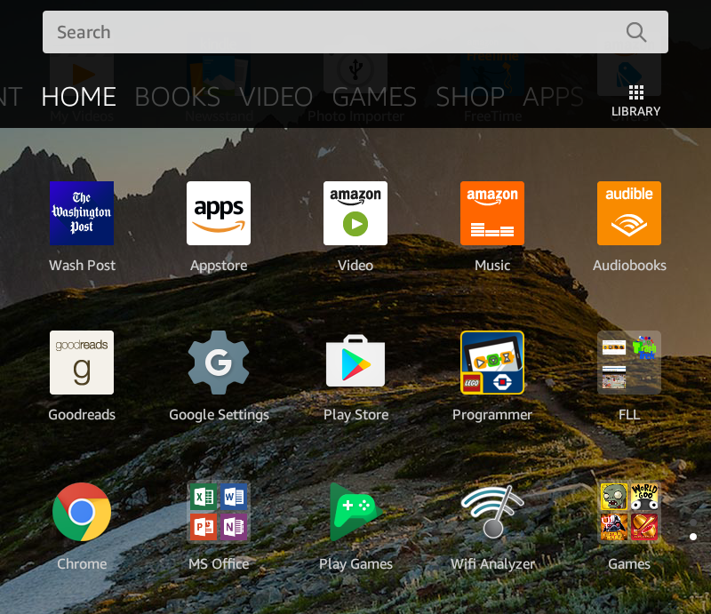
Launch Google Play
Launch Google Play and follow the setup instructions
You will now find Play Store amongst your applications

Slide 9
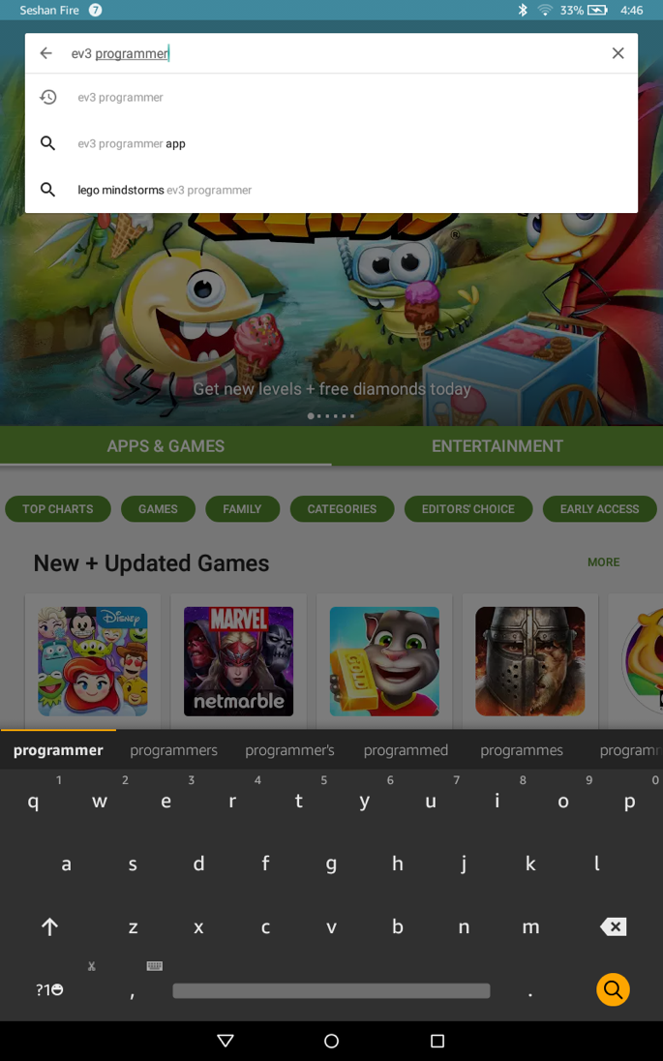
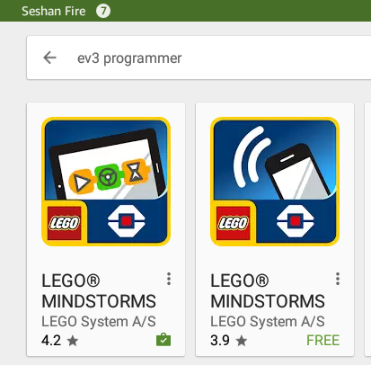
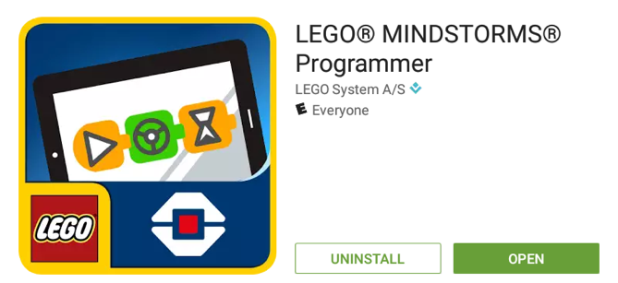
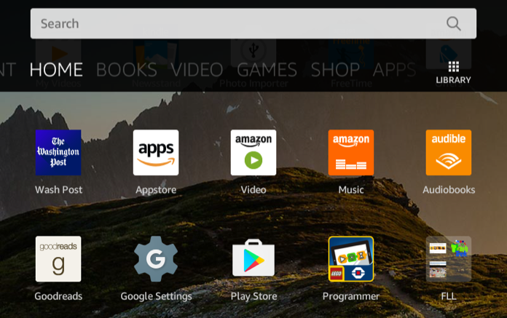
Install LEGO MINDSTORMS
INSTALL
Press install and accept all pop-ups
Choose the option that looks similar to the one selected above
Enter “EV3 Programmer” in the search bar
The app is now on the home screen

Slide 10
Credits
This lesson was written by Sanjay and Arvind Seshan
Original instructions and install scripts by Root Junky
More lessons are available on EV3Lessons.com
This work is licensed under a Creative Commons Attribution-NonCommercial-ShareAlike 4.0 International License.

